Slide 1
ORIGAMI SPACE RECYCLED
By Team Innovia

Slide 2
A Brief Introduction to the Problem
There is only so much volume a rocket can carry into space.
Solar Arrays, parachutes, habitats, storage tanks, inflatable aero-shells all could be packaged more effectively to enable more cargo on any given launch, or perhaps even reduce the number of launches needed to deliver goods to space.
Reducing weight and volume of storage components on a spacecraft is imperative in improving the efficiency and productivity of a space mission.

Slide 3
These principles of increasing packing and storage efficiency can be applied to various spaceship components such as solar sails, storage equipment and CUBESATS etc. Current principles can be improved upon and size constraints can be improved upon.

Slide 4
Some Existing Solutions
The Origami Flasher: Researchers at Brigham Young University, National Science Foundation, NASA's Jet Propulsion Laboratory, and origami expert Robert Lang designed a space array which can be folded compactly and then deployed while in outer space. When opened, the proposed disk-like array is 25 meters in diameter (82 feet) but when folded origami-style, it is only 2.7 meter (8.8 feet). This solves the problem of large arrays in narrow rockets.

Slide 5
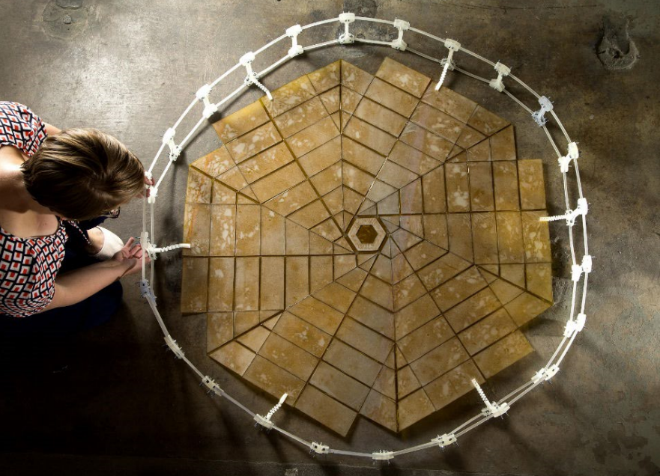
The Origami Flasher designed by Jeremy Shafer

Slide 6
Leonardo Permanent Multipurpose Module: A 21ft supply cupboard packed with goods and a humanoid robot were added to the International Space Station as its 13th room, used as a storage room. Named “Leonardo”, it provides much needed storage space and is expected to do so for the next decade.

Slide 7
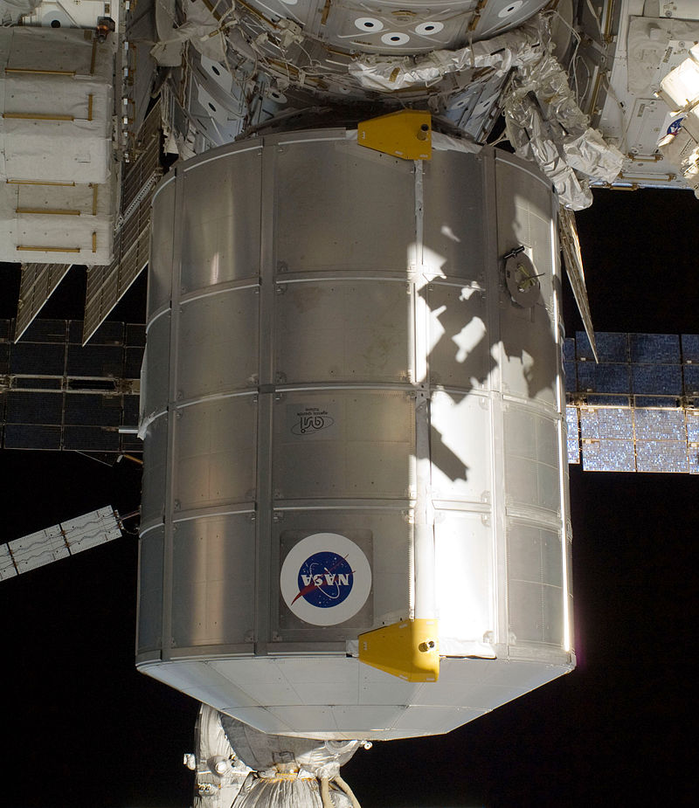
The Leonardo Permanent Multipurpose Module

Slide 8
OUR SOLUTIONS
The basic principle used to find solutions to said problem, is to maximise storage capacity while minimising volume and weight of the object in question.
Methods such as using low density and low weight materials for construction purposes has brought a lot of changes in the packing and storage scenario in space stations, but there are other, more space efficient solutions possible.

Slide 9
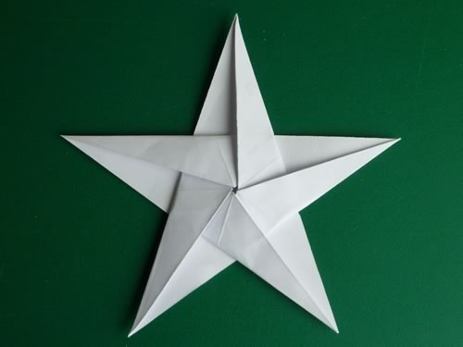
Origami is the art of paper folding, often associated with the Japanese culture, though not exclusively anymore. The goal in origami is to use sculpting and folding techniques to transform a square sheet of paper into a finished sculpture.

Slide 10
Researchers say origami could be useful one day in utilizing space solar power for Earth-based purposes. One of the possible products of this school of thought could be an orbiting power plant that wirelessly beams power down to Earth using microwaves. Sending the solar arrays up to space would be easy as they can all be folded and packed into a single rocket launch, with "no astronaut assembly required."

Slide 11
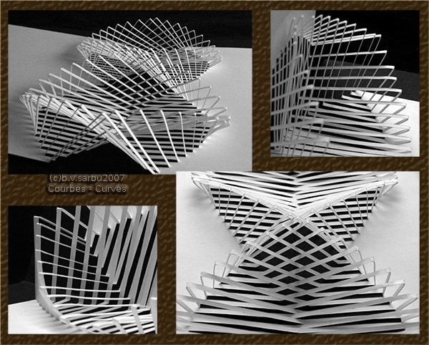
Using techniques of Origami and its sister technique Kirigami, a sheet of single carbon atoms-Graphene, has been manipulated into tiny complex structures like springs.

Slide 12
These techniques are increasingly influencing engineering and scientific research. Some mechanical properties of graphene mimicked those of a sheet of paper. The findings could pave the way to better flexible and stretchable electronics.

Slide 13
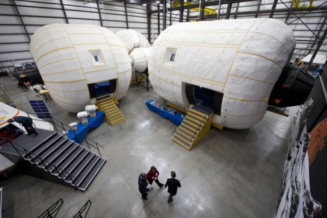
Inflatable habitats or expandable habitats: These are pressurized structures capable of supporting life in outer space whose internal volume increases after launch, solving a major issue of space conservation and efficiency optimisation.

Slide 14
They have been proposed for use in space applications to provide a greater volume of living space for a given mass. Because the diameter of the habitat is not strictly constrained by the diameter of the launch vehicle, inflatables can have a greater volume of living space for a given mass. These can be designed to have higher resistance to space debris.

Slide 15
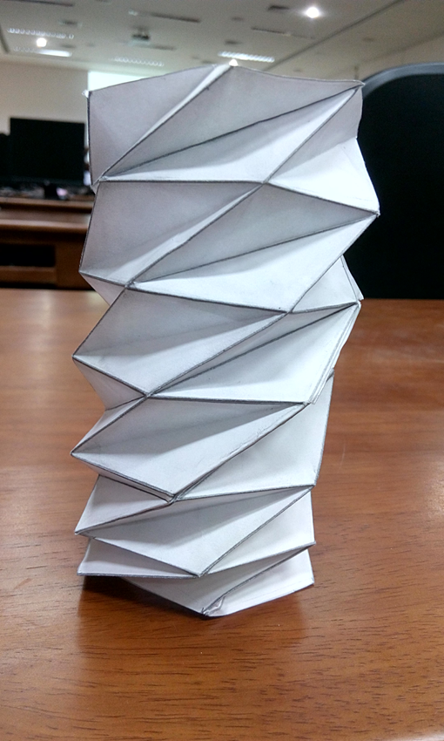
Foldable Origami Storage Unit

Slide 16
The Foldable Origami Storage Unit creates an alternative solution to the storage issues currently being faced.
It can be folded down to an almost 2D object, and be expanded when required.

Slide 17
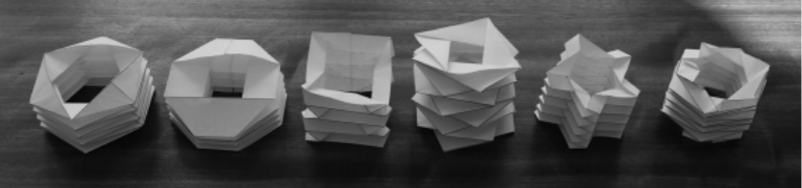
Different kinds of designable origami models

Slide 18
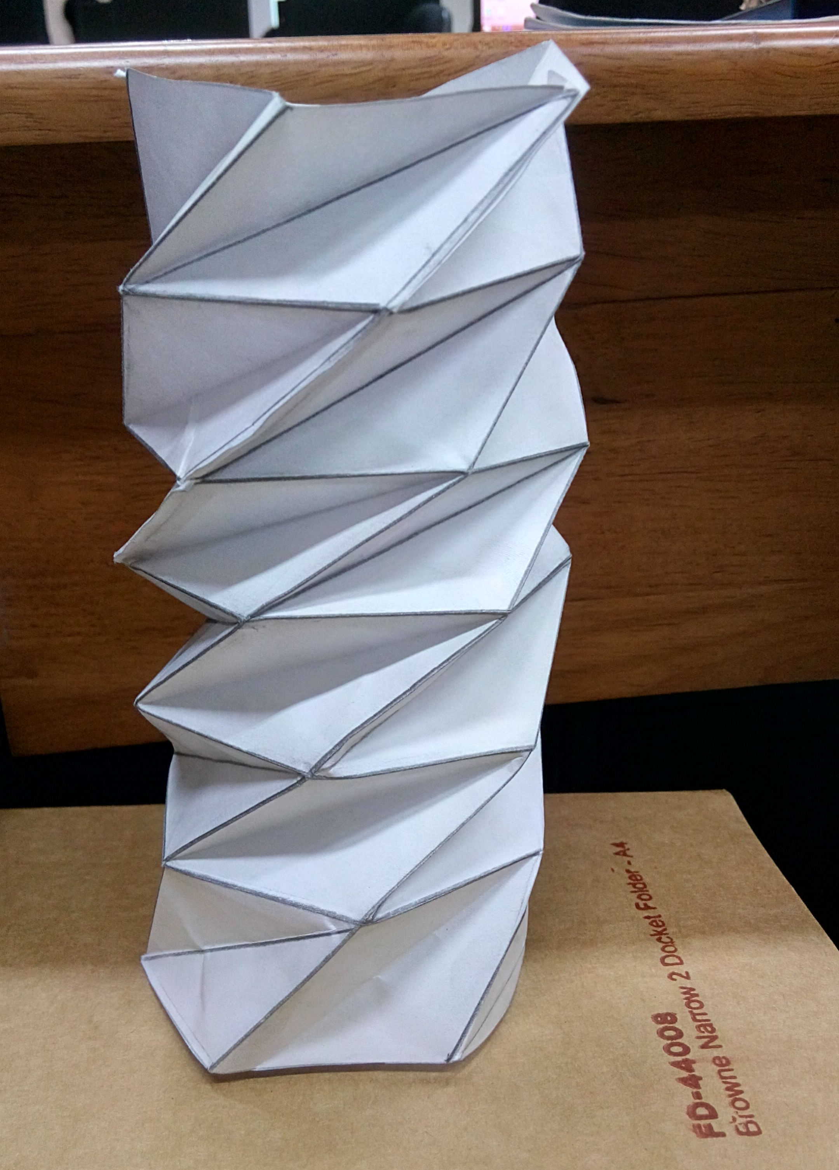
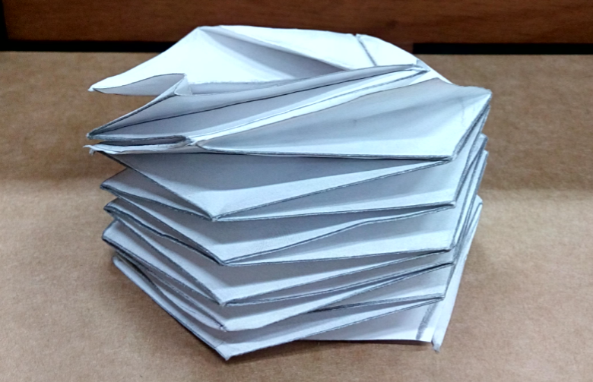
Expansion of the paper gives a hollow cylindrical structure.

Slide 19
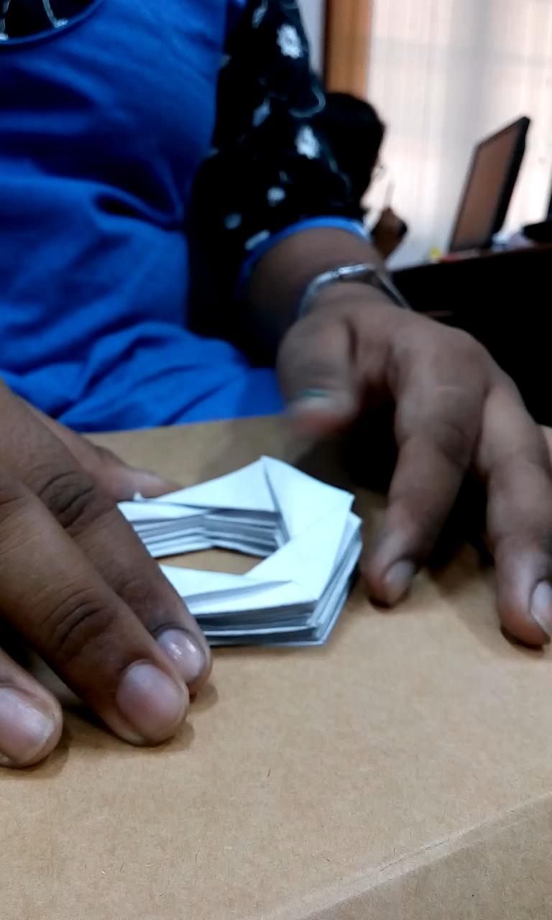
The expansion of the cylinder

Slide 20
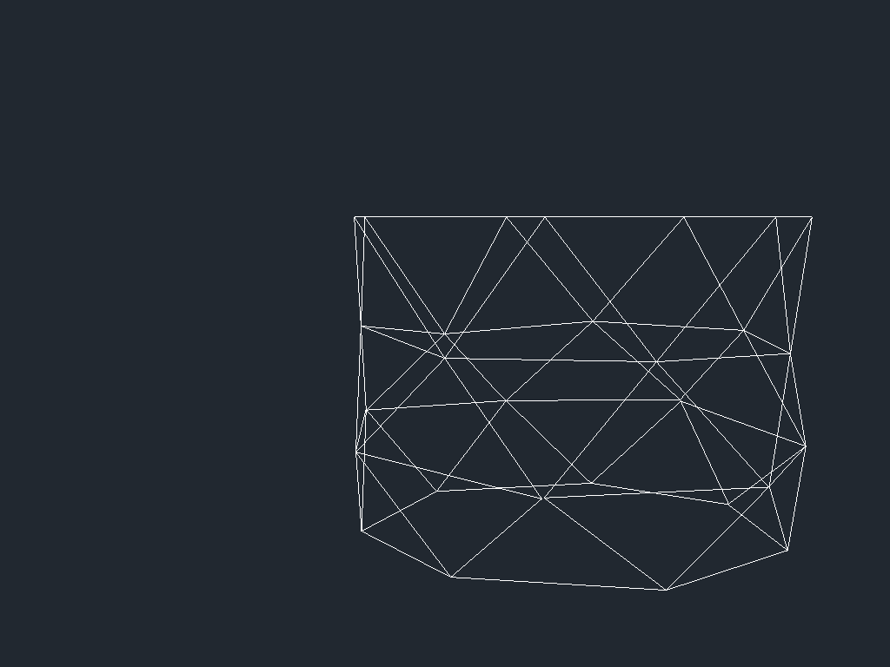
36o degree view of the expanded structure

Slide 21
Self Assembling Structures
The basic idea behind self assembly is creation of simple,small and modular structures that can be modeled into a number of structures of different size and shape.
The assembling units can be simple structures like triangles or cylinders.
They can be joined up in different ways to give different structures.
They are highly adaptable and can easily be assembled into different structures according to our requirements.

Slide 22
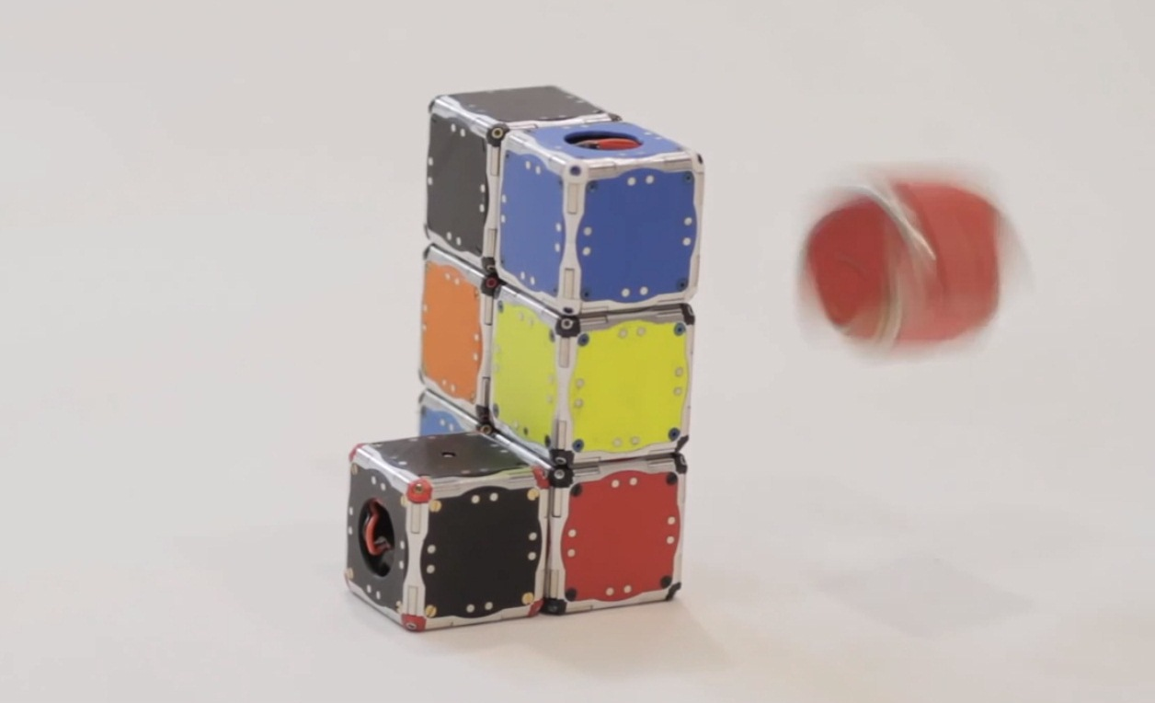
Self Assembling Cubots

Slide 23
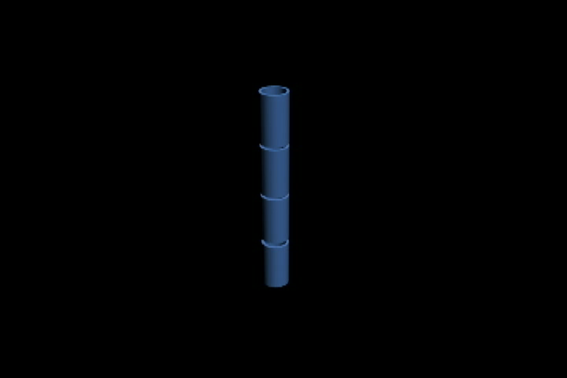
Self Assembling Cylinders

Slide 24
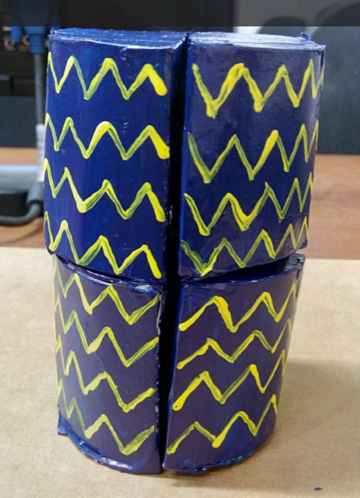
Self Assembling Storage Cylinders

Slide 25
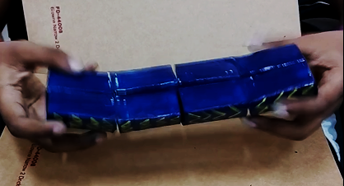
These structures consist of quarter cylinders connected together in a fashion that enables it to be made compact and stored efficiently due its reduced effective volume.
The quarter cylinders are hollow and can thus be used to store mission components, packed food etc.

Slide 26
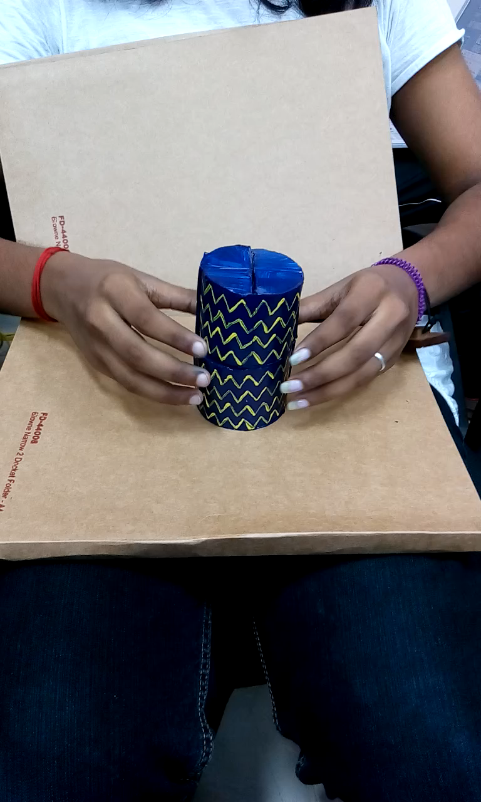
Assembly of the structure

Slide 27
Foldable Solar Panels
Solar panels, to be efficient, need to have a large surface area.
This however creates another problem, transporting these large panels to space.
Origami gives the solution to this using foldable solar panels.

Slide 28
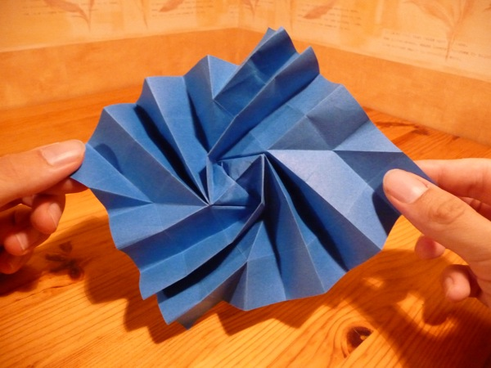
One famous example is the Jeremy Shafer designed Origami Flasher.
It can be unfolded in outer space to a large surface area and can be used as solar sails/panels.

